Slide 1
Chapter 4
Statistical Inference Using Simulation

Slide 2
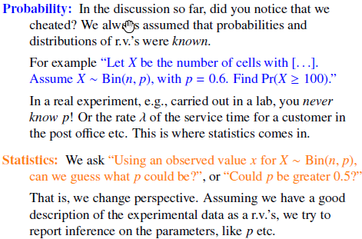
The Role of Probability in Statistical Inference

Slide 3
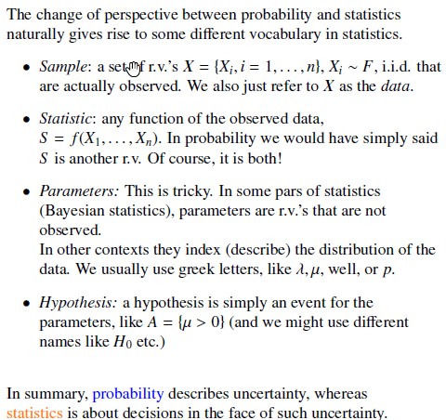

Slide 4
Transition
Probability
We describe uncertainty.
Statistics:
We make decisions in the face of uncertainty.

Slide 5
Example: Do We Like to Think? 1
A psychologist did an experiment where college students were asked to sit for 10 minutes in a room alone, just thinking, with no cellphones, books, etc.) Then they were asked whether the experience was pleasant or unpleasant.
13 of 25 said that
the experience was unpleasant.
Two different types of questions can be explored:

Slide 6
Example: Do We Like to Think? 2
1. Estimate the population proportion of college students at that university who would rate such an experience unpleasant.
2. Test the claim that the population proportion of college students at this university who would who find such an experience unpleasant is greater than 40%

Slide 7
Using Probability to Address These
How can we answer this using probability calculations and/or statistical methods?
What methods?
What additional assumptions are needed about the way the study was conducted to use those methods?
How “robust” is our answer against slight deviations from each of these conditions? (And how do we measure “robust” and “slight?”)

Slide 8
Estimating a Parameter
Standard method: Form and interpret a confidence interval for the parameter.
Pick some confidence level that is large enough for the user to consider it adequate to make their decision.

Slide 9
Testing a Claim: Method
Standard method:
State a claim of interest.
Decide on a counter-claim that is, more or less, “status quo.”
Do a probability calculation: Find the p-value: the probability of obtaining data that is as extreme or more extreme than the data that we have, if the”status quo” is really true.
Decide how to act, based on that probability.

Slide 10
Assumptions
What assumptions?
Sample has to be “large enough.” (Depends on the statistical method.)
Possible actions:
Generalize to some population. For this, the sampling method must be a probability-based method (simple random sampling, stratified sampling, etc.)
Consider this evidence for causality. For this, we must have an experiment where the values of the explanatory variable are randomly assigned to the subjects.

Slide 11
Obtain Information about the study
How was it designed?
How was it implemented?
If the report doesn’t make all that clear, how much do you know about the source of the study, and the reputation of the source?

Slide 12
How can we ever do anything with statistics?
Be aware of the assumptions.
Be aware that they are seldom “exactly” met.
Typical statistical practice includes many guidelines that help restrict application of the methods to situations where they are “robust” against reasonable deviations from them.

Slide 13
The Value of Deeper Understanding
A good understanding of the basics for the statistical calculations is very valuable in understanding HOW the particular results depend on the assumptions.
This is particularly useful in thinking about robustness of the results despite some deviations from some of the required assumptions.

Slide 14
Sampling Distributions

Slide 15
Sampling Distribution of a Statistic
The sampling dist’n of the statistic for individual samples of size n for a particular population is constructed by
Taking all possible samples of size n from that population
Computing the value of the statistic from each of those samples
Collecting all of those values of the statistic to comprise the sampling dist’n of the statistic from that population.

Slide 16
Using the Sampling Dist’n of a Statistic
From here, generally one would
compute summary statistics of that sampling dist’n and / or
graph it.
Then, make inferences about the parameter based on that information.

Slide 17
Our Data and Summary Statistic
Data from 25 individual students, whose results can be considered Bernoulli random variables.
Total “successes” can be considered to be Binomial(25,p)
What assumptions are we making about the data to do this? (same p, independent)
Statistics: making decisions. . . . What does that mean here?
Notes:
Statistics methods will give us an answer to “what is a reasonable value to believe p to be.”

Slide 18
Sampling dist’n of the sample proportion
On the next two slides we are reminded
that the actual probabilities of the
distribution are the same whether the random variable is called
The number of “ successes”
or
The sample proportion of “successes”

Slide 19
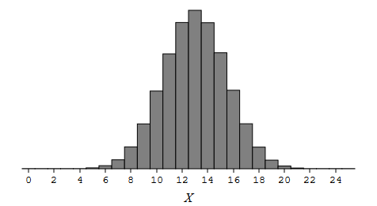
Sampling Dist’n for Count

Slide 20
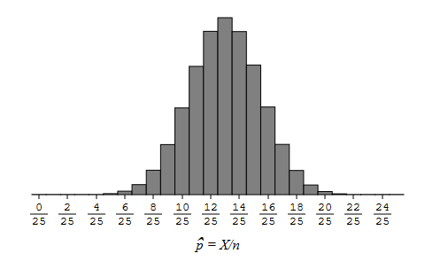
Sampling Dist’n for sample proportion

Slide 21
Which summary statistic do we use?
To estimate the pop’n parameter p, it makes sense to use a summary statistic that gives us good numbers to “plug in” for p.
We could “plug in” p-hat values for p, since the values of p-hat are “good approximations” of p. (In Math Stat terms, “p-hat is an unbiased estimator of p.”)

Slide 22
Exercise
Stop the video to review probability work.
What are the mean and variance of X?
Derive the mean and variance of p-hat = X/n .
3. After you have done these, resume the video to see the solutions.

Slide 23
Exercise Solutions
What are the mean and variance of X?
Mean of X = np Variance of X = np(1-p)
Derive the mean and variance of p-hat = X/n .
Mean of X/n = np/n and Variance of X/n
= p = (1/n²)np(1-p) = p(1-p)/n
Remember that these are quite different formulas, despite the fact that the useful information in the two dist’ns is the same.
Notes:
In my Math Stat classes it is not uncommon that students get these mixed up since the statistics X and p-hat convey the same information.

Slide 24
Will it always be this easy?
No.
Because the dist’n of the sum of the individual independent r.v.’s (Bernoulli) was a known dist’n (Binomial) and
the dist’n of the statistic we want is a constant multiple of the sum,
then
we had all we needed to find the sampling dist’n of the statistic.

Slide 25
What do we do next?
There are very few situations in which finding the sampling dist’n of the statistic we want is as easy as that.
In those situations, we go back to “basics” to think of how we might use computing power to simulate a sampling distribution of a statistic.

Slide 26
How strong is the evidence?

Slide 27
Back to basics: Simulation
Yes, we can “see” sampling distributions with a very general and useful method.
To do this, we will use a collection of tools that will always be freely available on the web.
StatKey www.lock5stat.com (Also has many datasets, with descriptions, and instructions of using it in “Videos.”)

Slide 28
Learn to use StatKey
Ideally, replicate the StatKey work as you watch the videos.
If something isn’t clear, stop and write a question. Keep track of your questions as you go through this. (And any answers to them you figure out!)
Ask your questions at least three times a week.

Slide 29
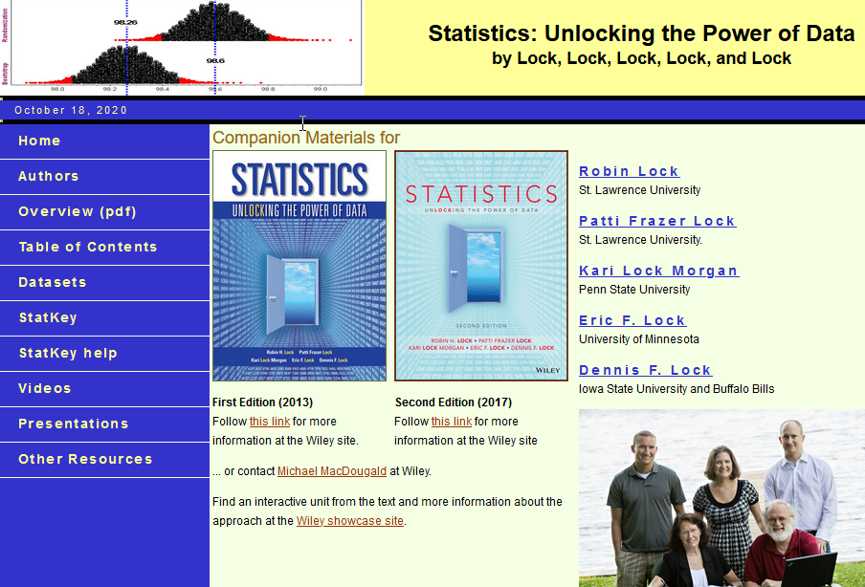
Notes:
Notice, in the left-hand menu, Datasets, StatKey, StatKey Help, and Videos.

Slide 30
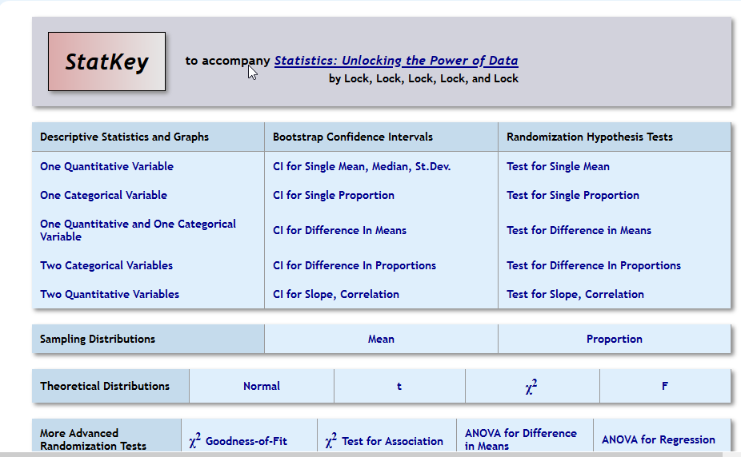
Notes:
Note that the middle one of the 5 horizontal boxes produces sampling distributions of two statistics.

Slide 31
Simulate a sampling dist’n
Let’s simulate a sampling dist’n for the statistic p-hat, when the pop’n we’re interested in is Bernoulli(0.40)
Population Bernoulli(p) where p = 0.40
Statistic: p-hat
Type of sampling: simple random sampling
Size of the sample we’re interested in: n = 25
How many “replications” we’ll do: maybe 6000

Slide 32
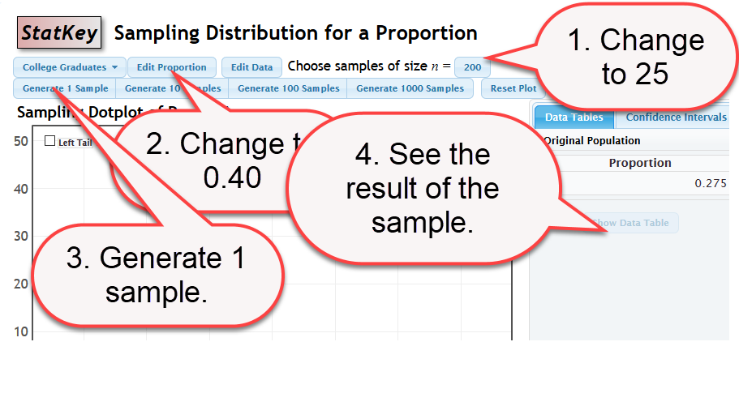

Slide 33
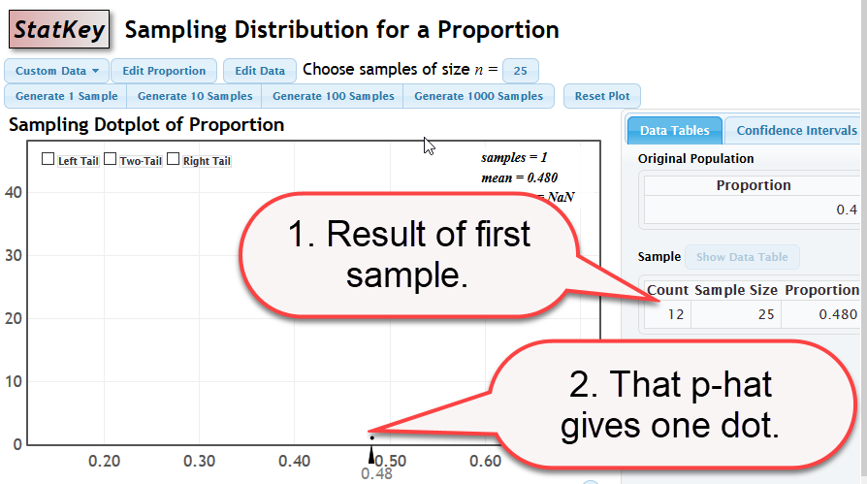

Slide 34
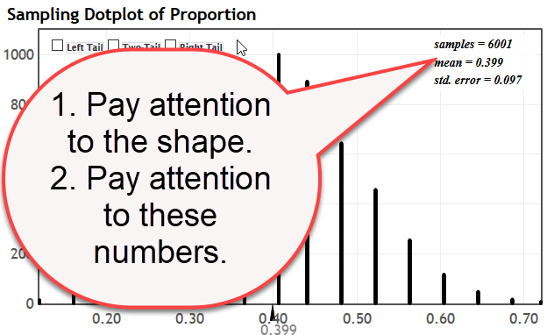
Generate MANY more replications.

Slide 35
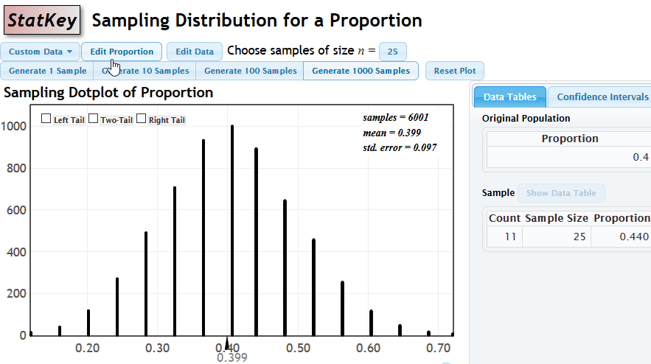
Simulated sampling dist’n of p-hat

Slide 36
Comments
Looks VERY much like the theoretical dist’n we graphed earlier for p-hat. A good approximation!
Made 6000 replications by generating them with the 1000 button just above the graph of the dist’n.
6000 is an arbitrary choice.
We didn’t choose a type of sampling. StatKey only does simple random sampling for its simulations.

Slide 37
New section begins

Slide 38
How strong is the evidence for….?
Back to one of our two example questions:
Test the claim that the population proportion of college students at this university who would who find such an experience unpleasant is greater than 40%.
So, let’s look at a (simulated) sampling dist’n of the sample proportion where p = 0.40 (the base value in our claim) and see where our sample proportion 13/25 = 0.52 falls.

Slide 39
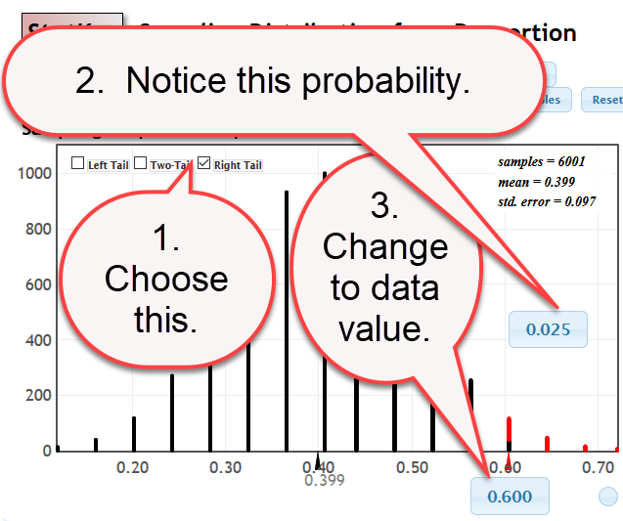

Slide 40
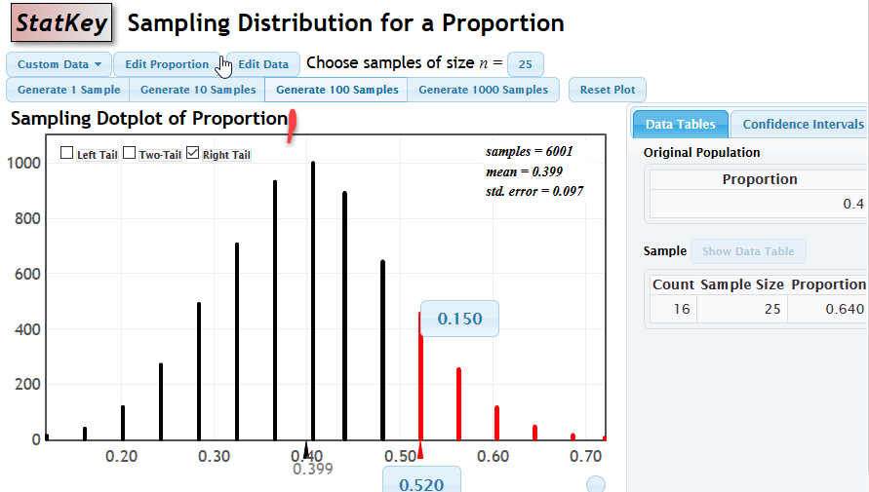

Slide 41
How strong is the evidence that p > 0.40?
Our evidence (p-hat= 0.52) seems much larger than 0.40. But then, the sample size isn’t very large. In terms of probability, about 15% of the values in the (simulated) sampling dist’n of the sample proportion, when p = 0.40 are that large or larger.
There is some evidence, but weak evidence, that the population proportion is larger than 0.40.

Slide 42
Do you remember hypothesis testing?
Ho: p =0.40 versus Ha: p > 0.40
The sampling distribution we just used is the distribution to use for this hypothesis test, and the p-value of the data we found is 0.150.
On the following page is the output for this problem from the StatKey tool for a hypothesis test of one proportion. It shows a p-value of 0.156.
This is, of course, consistent with our previous answer.
(Not exactly the same, but, of course, this is a simulation. ) In terms of probability, about 15% of the values in the (simulated) sampling dist’n of the sample proportion, when p = 0.40 are that large or larger.
There is some evidence, but weak evidence, that the population proportion is larger than 0.40.

Slide 43
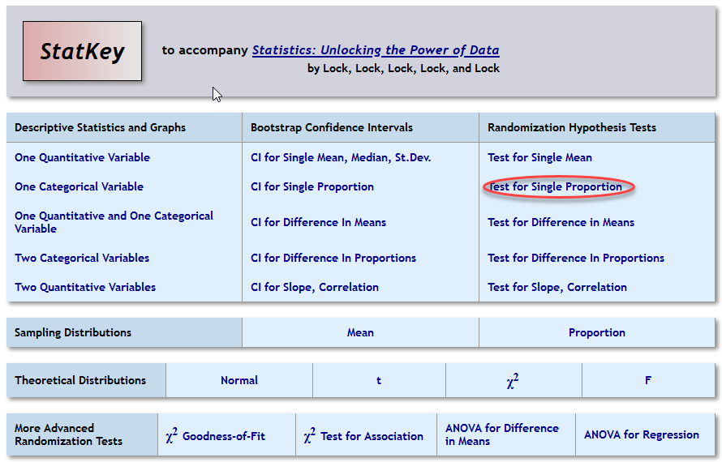
Notes:
Note that the middle one of the 5 horizontal boxes produces sampling distributions of two statistics.

Slide 44
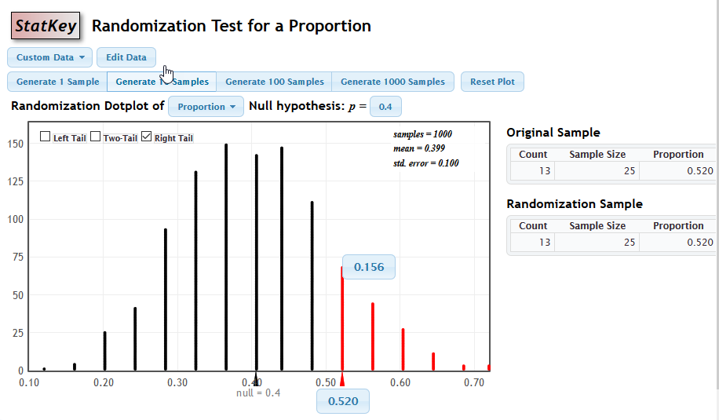

Slide 45
StatKey Sampling Dist’n Tools
StatKey only provides a sampling dist’n tool for two statistics: sample mean and sample proportion.
It provides tools for confidence intervals and hypothesis tests for the other statistics commonly used in standard applied statistics courses.

Slide 46
Going Forward: Questions
Here are some questions you might be thinking about:
How will I learn to use StatKey (or will I use something else?)
Will we review hypothesis testing more?
What sampling dist’n can we use for a confidence interval, since we don’t know the pop’n parameter to use for it?

Slide 47
Going Forward: Remarks
Yes, you may use other simulation software (or write some yourself.) In the course materials, I will provide documents and links to materials to help with StatKey.
Yes, I will demonstrate using StatKey to do a hypothesis test for a difference of two proportions.
Immediately after this slide, we will address confidence intervals using simulation.

Slide 48
Estimating a Parameter

Slide 49
XXXSteps: Hypothesis Testing in StatKey
In the right-hand column (Randomization Tests,) choose the appropriate parameters.
Put in the data (for proportions, use Edit Data and put in the count and the sample size.)
Put in the Ho value.
Generate many replications.
Choose the appropriate tails.
Put the test statistic value on the horizontal axis.
Read the p-value from the graph.

Slide 50
Estimating a parameter

Slide 51
Estimating a Parameter
Now, let’s shift our attention to the other question:
Estimate the population proportion of college students at that university who would rate such an experience unpleasant.

Slide 52
Estimate a population proportion
Our single-point estimate of the population proportion is our sample proportion.
We know that our sample with sample proportion 13/25 = 0.52 could easily have come from a population with population proportion of 0.53 or 0.50 or other values close to it.
How close?
And with what probability?

Slide 53
Estimate a population parameter
In statistical inference, we want to estimate parameters with an interval estimator. That is, we want to give a conclusion like this:
“I have 90% confidence that the true population parameter is between __ and ___.”
So we need to go some way on either side of our sample proportion.
How far?
And what does 90% have to do with how far?
Should we always go the same distance in either direction? Why or why not?

Slide 54
How to we DO it?
Generally speaking, we reinterpret that as: What are the middle 90% of the values of the sampling dist’n of p, when we use our sample proportion (rather than our theoretical idea of what the proportion is) to create the sampling dist’n?
We call that our 90% confidence interval for the population proportion, based on this sample.

Slide 55
How do we DO this in a theoretical dist’n?
Since our sample proportion is 0.52 and our sample size is 25,
we simply create a Bin(25,0.52) distribution
and pick some endpoints that cut off the outer 10% of the values,
which we would usually do by cutting off 5% on each end.
The following graph has 90% of the area in the middle and 5% cut from each end.
The 90% confidence interval is 0.373 to 0.706.

Slide 56
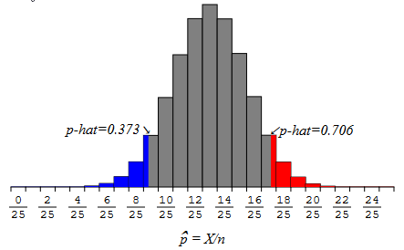

Slide 57
Why were some of the bars split?
In this discrete distribution, you saw that, to get 5% on each end, we had to “split” some bars, which seems a bit strange.
On the other hand, it is also strange to limit our view of possible endpoints to just the values along the horizontal axis that outline the “bars” indicating the probabilities of the various integer values of X.
The difficulty is, of course, that our population parameter p is defined on the entire interval from 0 to 1, but our sample proportion in this distribution only takes on 26 different values.

Slide 58
Sidelight: What we REALLY do in a theoretical dist’n
In practice, our theoretical approach is to avoid this issue: approximate this with a continuous distribution and compute probabilities in it. (If the conditions for that approximation are met.)
As you may remember from a previous statistics course, we approximate this with a normal dist’n, matching the mean and variance of the normal dist’n to the mean and variance of this discrete dist’n.

Slide 59
How do we DO it using simulation? 1
We use an idea called “Bootstrapping.”
(Do you know the saying “Pull yourself up by your bootstraps”? It was a 19th century saying to describe doing something by your own efforts that might have seemed impossible.)
Let’s start a “picture” of how we do it. Here are the 25 values from our sample:
0, 0 ,0, 0, 0, 0 ,0, 0, 0, 0 ,0, 0, 1, 1, 1, 1, 1, 1, 1, 1, 1, 1, 1, 1, 1, 1, 1, 1, 1

Slide 60
0, 0 ,0, 0, 0, 0 ,0, 0, 0, 0 ,0, 0, 1, 1, 1, 1, 1, 1, 1, 1, 1, 1, 1, 1, 1, 1, 1, 1, 1
0, 0 ,0, 0, 0, 0 ,0, 0, 0, 0 ,0, 0, 1, 1, 1, 1, 1, 1, 1, 1, 1, 1, 1, 1, 1, 1, 1, 1, 1
0, 0 ,0, 0, 0, 0 ,0, 0, 0, 0 ,0, 0, 1, 1, 1, 1, 1, 1, 1, 1, 1, 1, 1, 1, 1, 1, 1, 1, 1
0, 0 ,0, 0, 0, 0 ,0, 0, 0, 0 ,0, 0, 1, 1, 1, 1, 1, 1, 1, 1, 1, 1, 1, 1, 1, 1, 1, 1, 1
0, 0 ,0, 0, 0, 0 ,0, 0, 0, 0 ,0, 0, 1, 1, 1, 1, 1, 1, 1, 1, 1, 1, 1, 1, 1, 1, 1, 1, 1
0, 0 ,0, 0, 0, 0 ,0, 0, 0, 0 ,0, 0, 1, 1, 1, 1, 1, 1, 1, 1, 1, 1, 1, 1, 1, 1, 1, 1, 1
0, 0 ,0, 0, 0, 0 ,0, 0, 0, 0 ,0, 0, 1, 1, 1, 1, 1, 1, 1, 1, 1, 1, 1, 1, 1, 1, 1, 1, 1
0, 0 ,0, 0, 0, 0 ,0, 0, 0, 0 ,0, 0, 1, 1, 1, 1, 1, 1, 1, 1, 1, 1, 1, 1, 1, 1, 1, 1, 1
0, 0 ,0, 0, 0, 0 ,0, 0, 0, 0 ,0, 0, 1, 1, 1, 1, 1, 1, 1, 1, 1, 1, 1, 1, 1, 1, 1, 1, 1
0, 0 ,0, 0, 0, 0 ,0, 0, 0, 0 ,0, 0, 1, 1, 1, 1, 1, 1, 1, 1, 1, 1, 1, 1, 1, 1, 1, 1, 1
0, 0 ,0, 0, 0, 0 ,0, 0, 0, 0 ,0, 0, 1, 1, 1, 1, 1, 1, 1, 1, 1, 1, 1, 1, 1, 1, 1, 1, 1
0, 0 ,0, 0, 0, 0 ,0, 0, 0, 0 ,0, 0, 1, 1, 1, 1, 1, 1, 1, 1, 1, 1, 1, 1, 1, 1, 1, 1, 1

Slide 61
How do we think about it using simulation?
We think of our sample as “just like” the population. (After all, it’s all the information we really have to use about our population.)
So we, essentially, duplicate our sample over and over until we get MANY values – enough to be as big as the population.
And then we sample from that –
taking 25 values at random
to compute one sample statistic as our first value for the bootstrap dist’n.
We sample from that MANY times until we get enough (what do you think? 1000, 6000, 9000?) to feel comfortable that it’s a large enough bootstrap distribution to simulate the variability in the of the sampling dist’n of the sample proportion.

Slide 62
How do we ACTUALLY do it?
To actually DO, this, we simply take simple random samples of size 25, with replacement, from the original sample. (Of course, we have computer software do this!)
And, each of those bootstrap samples has a sample proportion. We collect all of those values into what we call a bootstrap distribution for the sample proportion.
In that distribution, we look at the middle 90% and find the endpoints to form the 90% confidence interval.

Slide 63
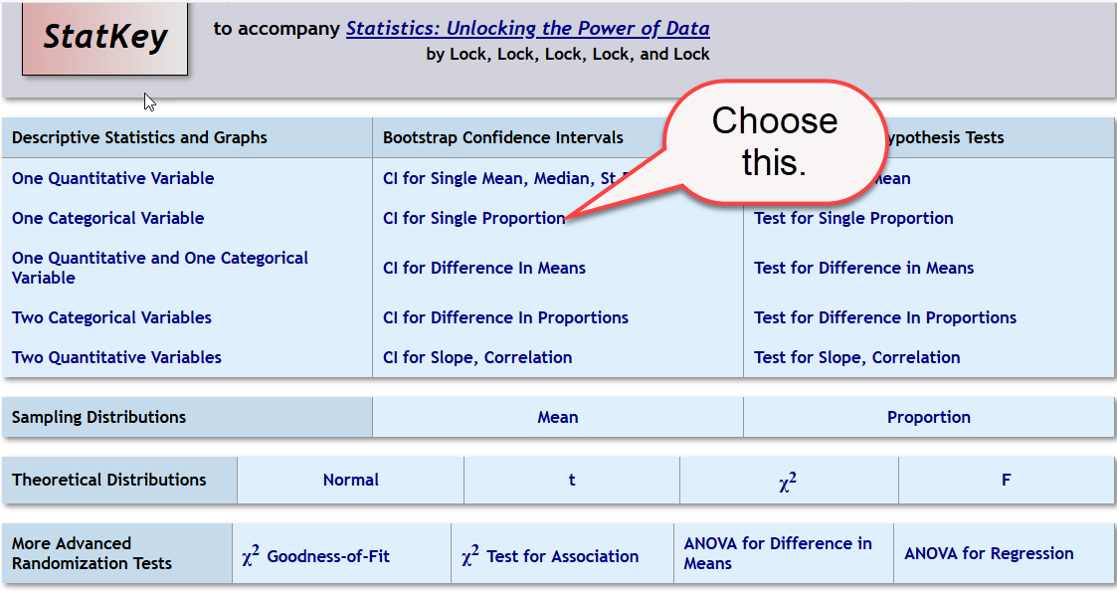

Slide 64
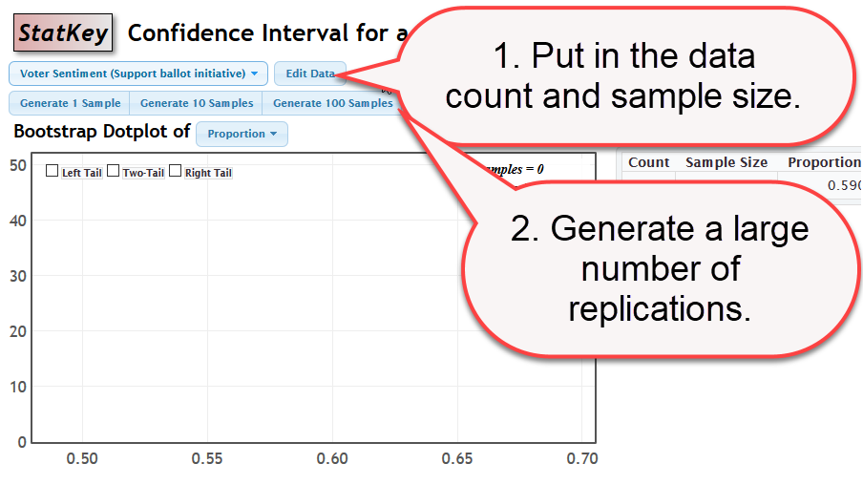

Slide 65
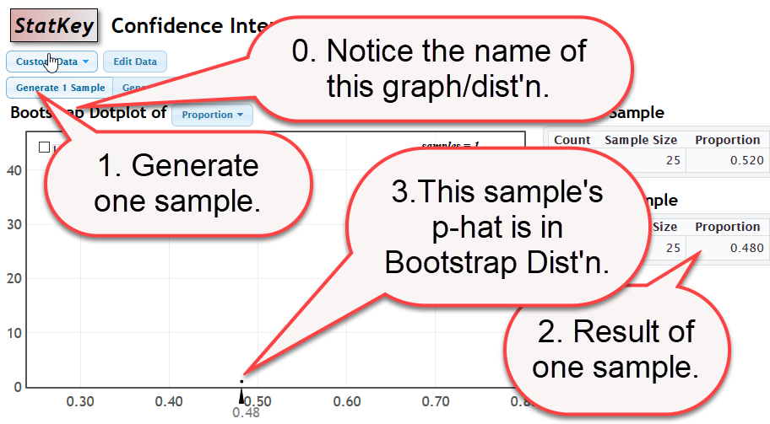

Slide 66
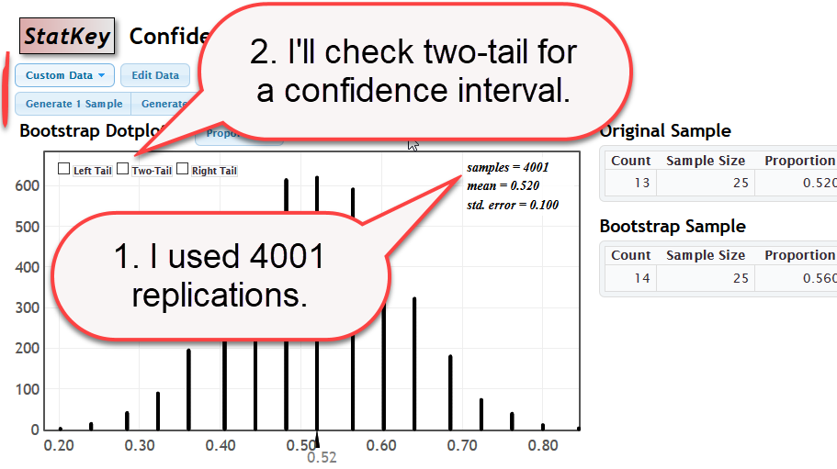

Slide 67
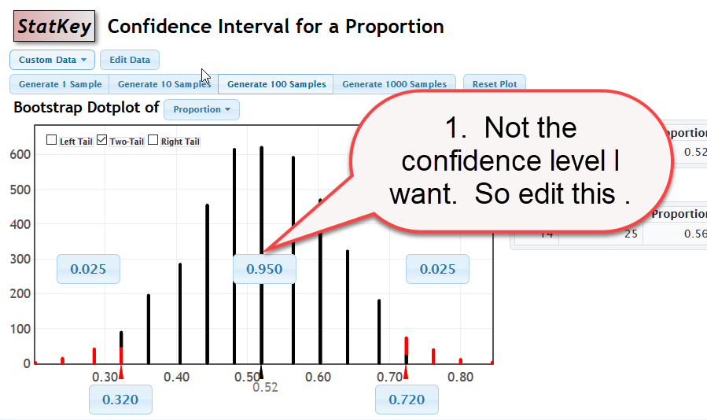

Slide 68
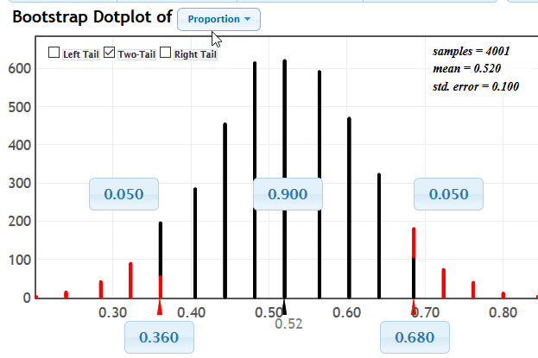

Slide 69
Conclusion for estimating a parameter
Estimate the population proportion of college students at that university who would rate such an experience unpleasant.
Answer: I have 90% confidence that the population proportion of students who are uncomfortable in this situation is between 0.36 and 0.68.
Assumptions we’re making for this conclusion:
The students in the study are, essentially, a random sample of students at that university.
The study was designed appropriately (e.g. all the students were treated in the same way, etc.)

Slide 70
Meaning of a Confidence Interval

Slide 71
Possible misunderstanding
It is important not to get too focused on the actual endpoints of the confidence interval.
The 90% confidence in our result is, essentially, a confidence in the process giving us an interval that, when the process is repeated, the probability that the interval contains the true population parameter is 90%.
Following are illustrations of the meaning of this.

Slide 72
Illustrating the meaning of a CI.
Notice that EVERY value we generate in a sampling distribution is a value that might have occurred for our dataset.
Thus every value in the sampling distribution could be the center of a confidence interval for the parameter.
Some of those values are far out in the tail of the sampling dist’n, so confidence intervals from them do not contain the actual population proportion.

Slide 73
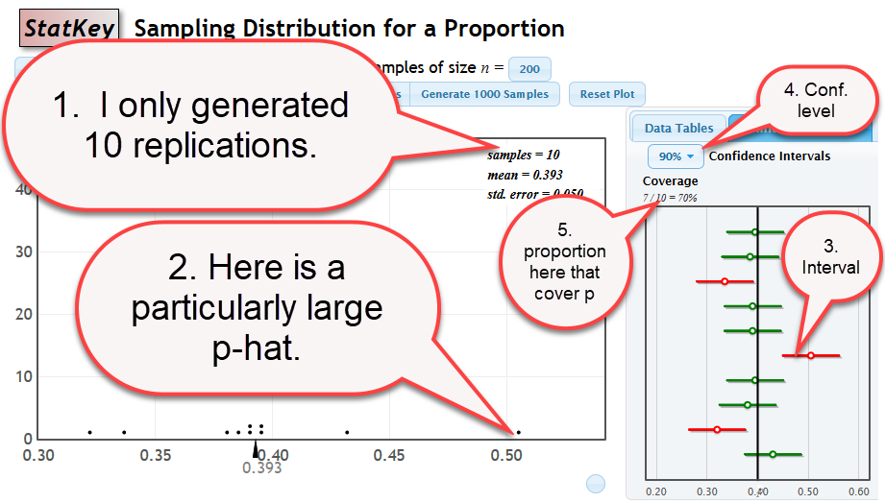

Slide 74
Specific Illustration of Meaning of a CI
I generated only ten replications from this sampling distribution.
I identified a particular one of those replications – the one with the largest value.
I chose to display the confidence intervals (right top instead of the data table.)
I looked at the confidence interval that has the largest values in it, because that comes from the largest value in the displayed values in the sampling dist’n.
I chose to display 90% confidence intervals.
I noticed that 70% of these ten intervals contain the population parameter (in a tiny display box) and obviously 3 out of 10 do not, when I look at the picture.

Slide 75
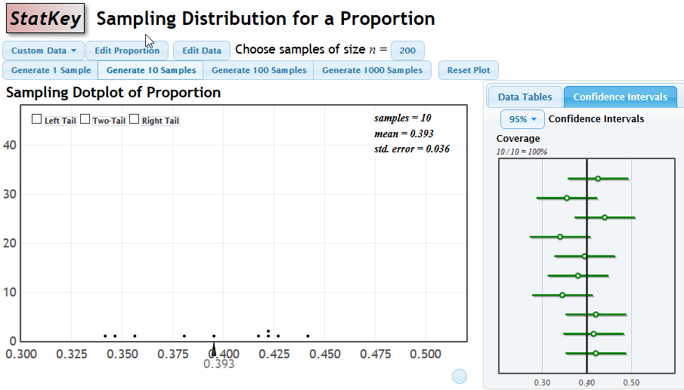
Another illustration of the same.

Slide 76
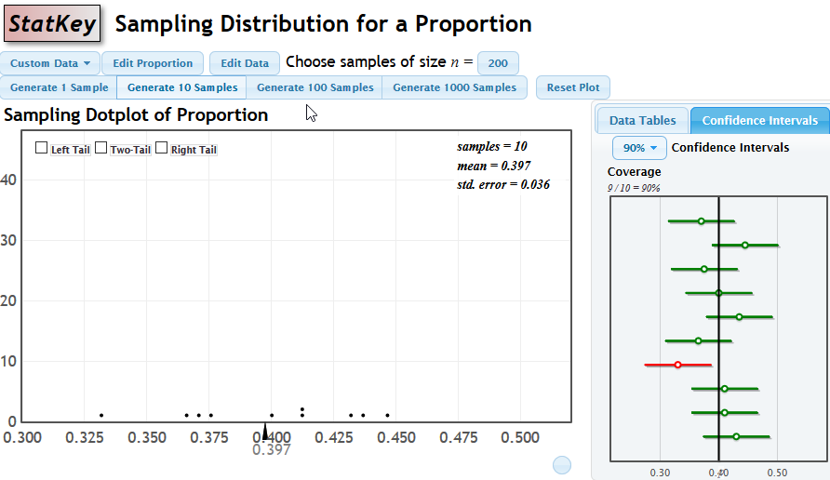
A third illustration of the same

Slide 77
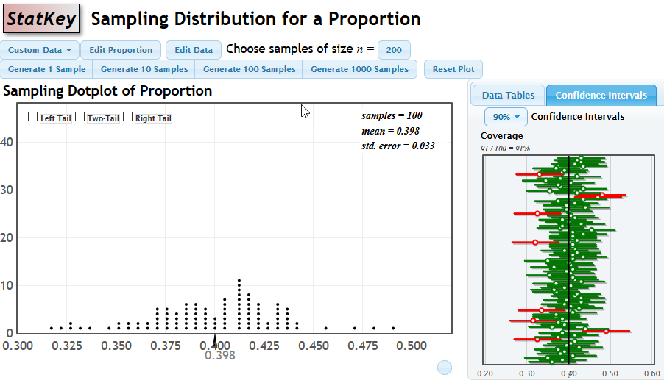
A fourth illustration with 100 CIs

Slide 78
Meaning of a Confidence Interval
If we carry out the process of taking a sample from the pop’n, computing the statistic value from it, and forming a 90% confidence interval with that value in the center
Then
On the average, 90% of the resulting intervals will contain the actual pop’n parameter.

Slide 79
Summary of Chapter A
Two types of statistical questions: Estimation and Testing a claim
Main idea: Each is answered in the sampling dist’n of a statistic
Technique: We can simulate the appropriate sampling dist’ns
Testing a claim: Uses the sampling dist’n of the statistic if our claim about the parameter is true. (Center is at the claimed parameter value)
Estimating a parameter: Bootstrapping gives us an approximation of the population from which we generate the bootstrap distribution of the statistic. We use that to approximate the shape and variability of the sampling distribution. We note that it holds no additional information about the center of the sampling dist’n than the sample statistic has. (Center is at the value of the sample statistic.)
Meaning of a confidence interval: The “90% claim” is about the process of generating values in the dist’n, not about the individual values of the endpoints of the interval.

